Slide 1
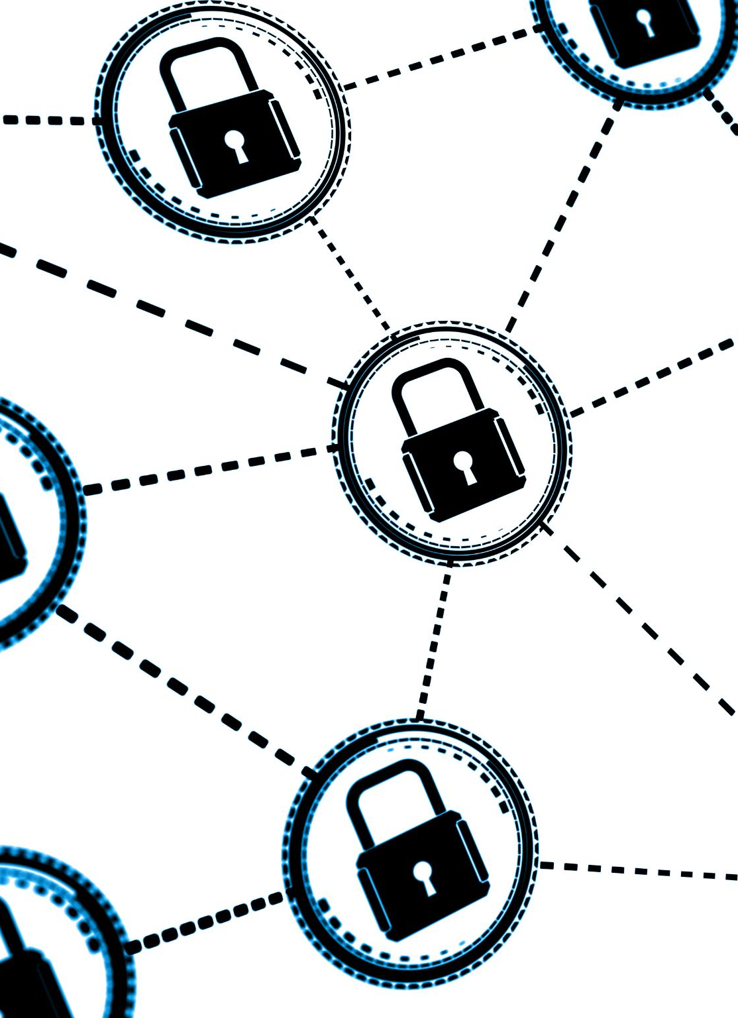
Safe Internet & Email Usage
Best practices to protect your online communications
Presented By: Arr Domingo
Notes:
---

Slide 2

Topic Overview
Introduction to Safe Usage
  Focus on secure browsing, avoiding malicious links, and handling email attachments safely.
Organizational Risk Awareness
  Understanding how unsafe online behavior exposes the organization to cybersecurity threats.
Realistic Risk Scenarios
  Examples demonstrating potential security breaches from unsafe internet and email use.
Best Practices and Mitigation
  Sharing actionable best practices to mitigate risks and protect organizational assets.
Notes:
Safe Internet & Email Usage is a critical component of cybersecurity awareness that focuses on secure browsing habits, avoiding malicious links, handling email attachments safely, and adhering to acceptable use policies. This section introduces the topic and outlines what employees will learn, including the definition of safe practices, why these practices matter to Wayne Enterprise, realistic risk scenarios, consequences of unsafe behaviors, and best practices for mitigation. Employees will understand that every click and interaction online can either protect or expose the organization to threats. The agenda includes five key points: defining the topic, explaining organizational risk, presenting realistic examples, discussing consequences, and sharing actionable best practices. By setting clear expectations upfront, this section ensures that employees are prepared to engage with the material and apply it to their daily work routines.

Slide 3
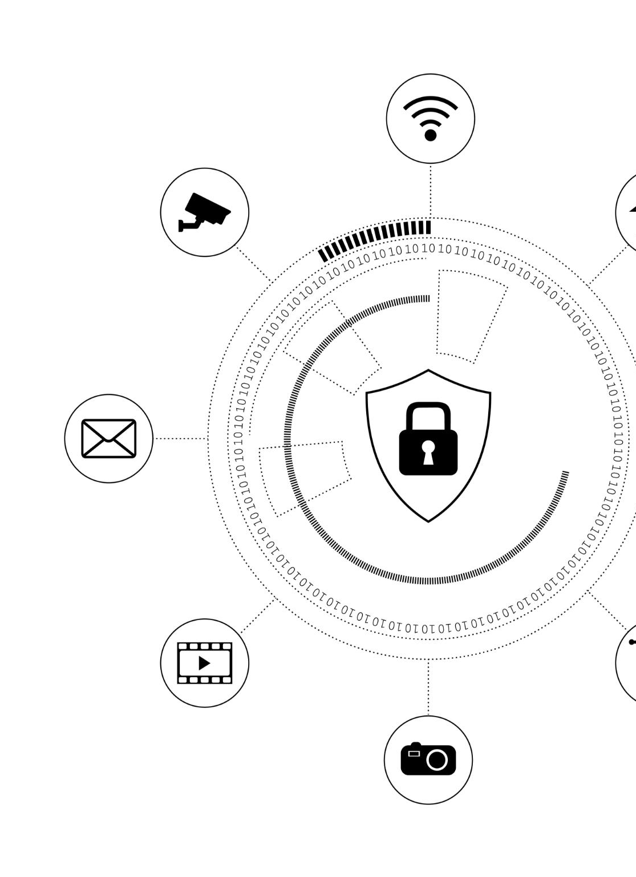
Why Is This a Risk to Wayne Enterprise
Risk from Internet Usage
  Heavy reliance on internet and browsing exposes systems to malware, ransomware, and data breaches.
Email Threats and Phishing
  Phishing emails and malicious attachments pose a significant threat to corporate information security.
Consequences of Cyberattacks
  Cyberattacks can cause financial loss, operational disruption, and damage to organizational reputation.
Human Error Exploitation
  Attackers use social engineering to exploit employee mistakes, increasing vulnerability to attacks.
Notes:
Wayne Enterprise relies heavily on internet and email communication for daily operations, making these channels prime targets for cyberattacks. Employees frequently access external websites and receive numerous emails, some of which may contain phishing attempts or malicious attachments. Unsafe browsing can lead to malware infections, ransomware attacks, and data breaches, while careless email handling can expose sensitive corporate information. The organization faces risks such as financial losses, operational disruptions, and reputational damage if employees fail to follow safe practices. Attackers often exploit human error, using social engineering tactics to trick employees into clicking harmful links or downloading infected files. Understanding these risks is essential for maintaining the integrity of company systems and protecting confidential data from unauthorized access.

Slide 4
Realistic Examples of Scenarios
Phishing Email Tactics
Phishing emails often mimic internal communications to trick employees into revealing personal information or clicking malicious links.
Unsafe Web Browsing
Visiting unverified websites or downloading unknown software introduces malware and security threats to the network.
Workplace Device Misuse
Using workplace devices for personal activities can expose the network to vulnerabilities and security breaches.
Notes:
Common scenarios include phishing emails disguised as internal HR communications requesting employees to update personal information, links embedded in emails that redirect to fake login pages, and attachments containing malware sent from seemingly legitimate sources. Unsafe web browsing, such as visiting unverified websites or downloading free software from unknown sources, can also introduce threats. Another example is mishandling workplace devices by using them for personal activities that expose the network to vulnerabilities. These examples highlight how everyday actions can lead to severe consequences if employees are not vigilant. By recognizing these scenarios, employees can better identify suspicious activities and take preventive measures before harm occurs.

Slide 5

Consequences of Unsafe Practices
Data Breaches and Legal Risks
  Unsafe practices can lead to data breaches exposing confidential information, causing legal liabilities and regulatory penalties.
Financial Losses from Cyberattacks
  Ransomware and fraudulent transactions due to compromised accounts can result in significant financial losses for organizations.
Reputational Damage
  Unsafe internet practices damage client trust and harm business relationships, affecting organizational reputation negatively.
Operational Disruptions
  Malware infections can halt critical business processes, reduce productivity and impacting profitability.
Notes:
Failing to follow safe internet and email practices can result in significant consequences for both employees and the organization. Data breaches may expose confidential company information, leading to legal liabilities and regulatory penalties. Financial losses can occur due to ransomware attacks or fraudulent transactions initiated through compromised accounts. Additionally, reputational damage can erode client trust and impact business relationships. Operational disruptions caused by malware infections can halt critical processes, affecting productivity and profitability. These consequences underscore the importance of proactive measures and adherence to security protocols to safeguard organizational assets and maintain business continuity.

Slide 6
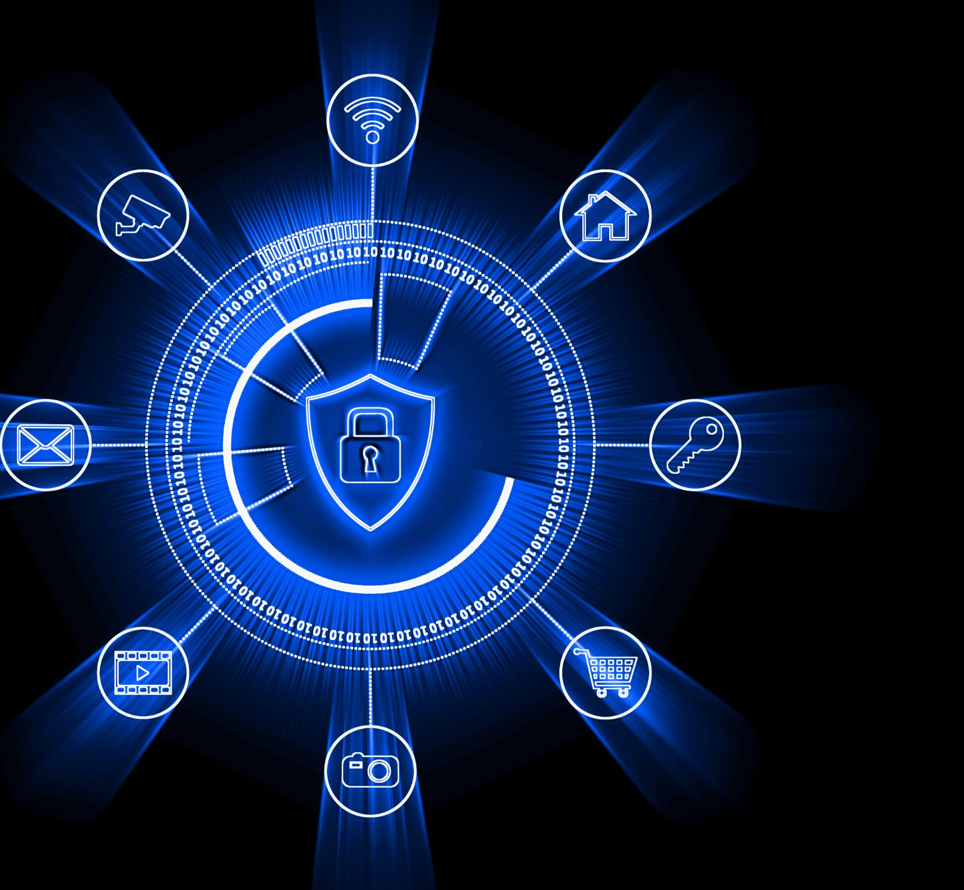
Best Practices and Recommended Mitigations
Verify Email Senders
  Always confirm sender authenticity before clicking links or downloading attachments to avoid phishing threats.
Use Secure Browsers
  Employ secure browsers and avoid suspicious websites to minimize exposure to malware and unauthorized software.
Follow Company Policies
  Adhere to acceptable use policies on workplace devices to prevent vulnerabilities and maintain security.
Update Software Regularly
  Keep software and antivirus programs up to date to protect against emerging cyber threats effectively.
Notes:
Employees should adopt several best practices to mitigate risks associated with internet and email usage. Always verify the sender before clicking links or downloading attachments, and be cautious of emails requesting sensitive information. Use secure browsers and avoid visiting suspicious websites or downloading unauthorized software. Follow the company’s acceptable use policies for workplace devices to prevent exposure to vulnerabilities. Enable email filtering tools and report suspicious messages to the IT department immediately. Regularly update software and antivirus programs to ensure protection against emerging threats. By implementing these measures, employees can significantly reduce the likelihood of cyber incidents and contribute to a safer digital environment within the organization.

Slide 7

Key Takeaways
Importance of Safe Usage
  Safe internet and email usage protects both personal and organizational data from cyber threats.
Best Practices
  Verify links and attachments, follow policies, and report suspicious activity promptly to IT.
Preventing Cyber Threats
  Safe browsing and cautious email handling prevent malware, phishing, and data breaches.
Ongoing Awareness
  Stay informed about threats with regular training and use secure tools to enhance protection.
Notes:
Employees should remember that safe internet and email usage is essential for protecting both personal and organizational data. Key takeaways include verifying links and attachments before interacting with them, adhering to acceptable use policies, and reporting suspicious activity promptly to IT. Safe browsing habits and cautious email handling can prevent malware infections, phishing attacks, and data breaches. By following these guidelines, employees play a vital role in maintaining cybersecurity and ensuring the continued success and reputation of Wayne Enterprise. Actionable advice includes thinking before clicking, using secure tools, and staying informed about emerging threats through regular training and updates.

